Slide 1


Ordering face dataset using manifold learning
Chen Zhang, Saheli Bhattacharya, Han Peng
CSIC5011 Group Project
08/05/2024
Notes:
Hello everyone. My name is Han, and this is Saheli, this is Chen. Today we are going to talk about our final project of Ordering face dataset using manifold learning.

Slide 2
Introduction
Notes:
So first introduction.

Slide 3
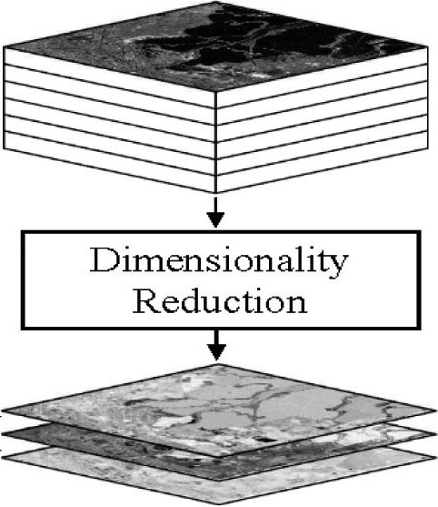
Why Dimensionality Reduction?
Simplify Data
Preserve the essential structure
Solves computational problem
Solves Overfitting
Manifold Learning-A valuable tool
Notes:
Why dimensionality reduction.
Because we want to deal with high-dimensional data by finding out its low dimensional structure to simply data and solve complex problems
In this project we will explore different manifold learning methods to find out the correct order of a face dataset.

Slide 4
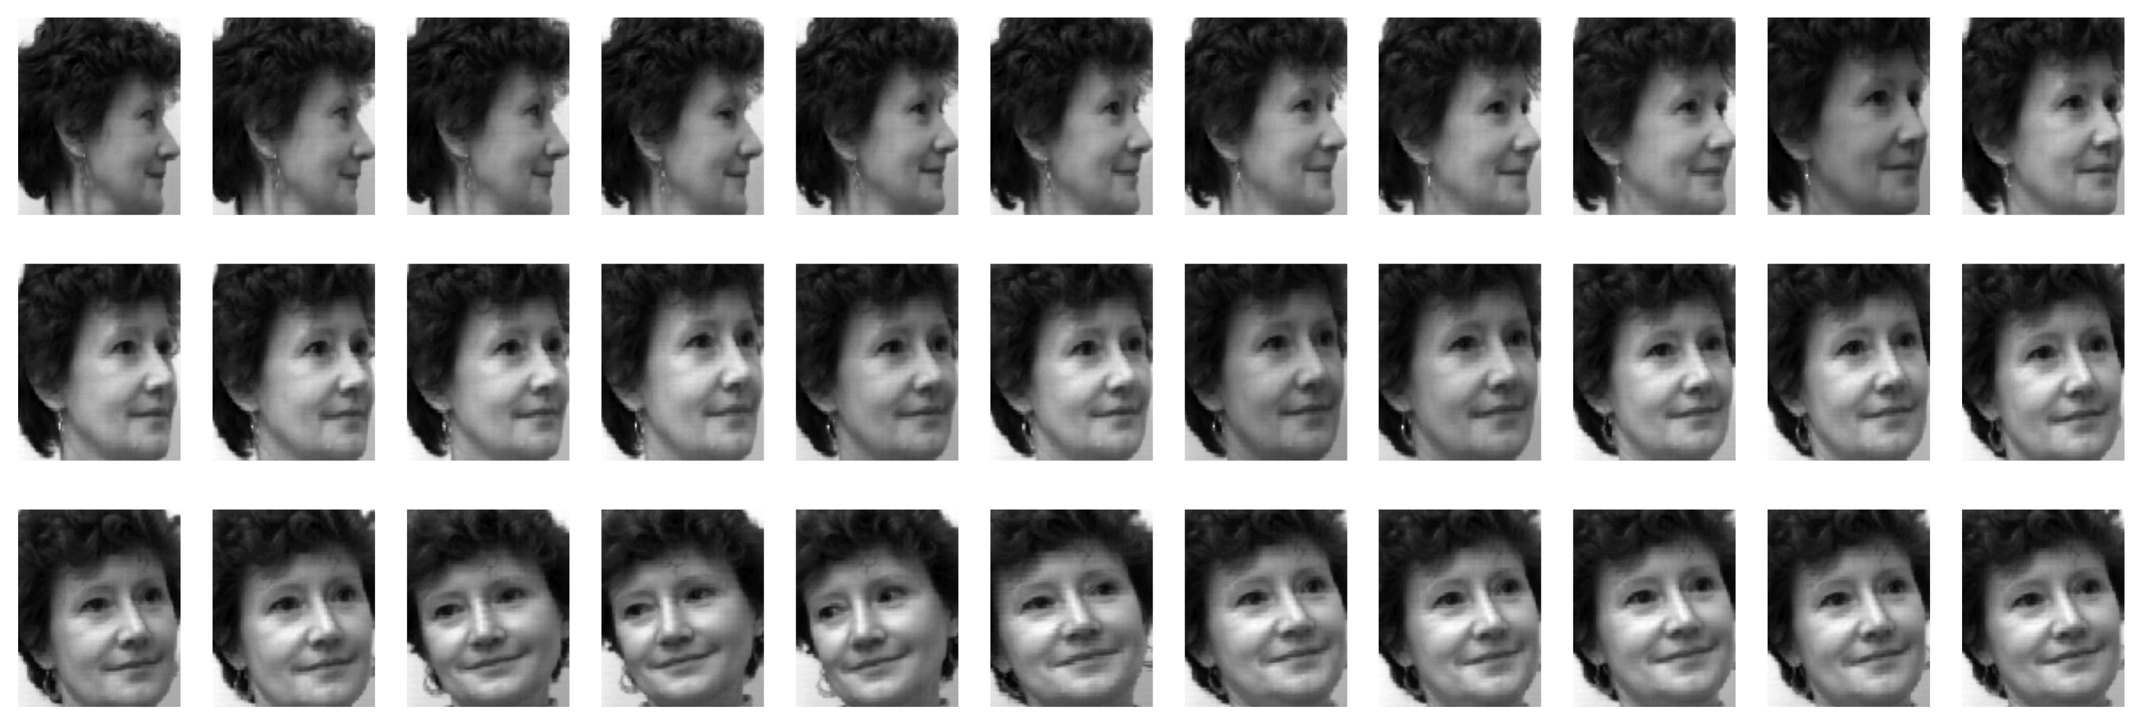
Dataset
33 images of the same individual captured from various angles
The dataset, denoted as Y and represented by a three-dimensional matrix of size 112x92x33
Order feature: right -> left -> right; smooth transition, but not follow a single direction change, pose challenges
Used six manifold learning methods: Diffusion map, MDS, LSTA, t-SNE, ISOMAP, and LLE
Notes:
The face dataset consists of 33 images of the same individual captured from various angles.
This is ground truth order.
Although the overall order transition is smooth, the angle change does not follow a single direction.
As we will see later, this can pose challenges to determine the correct face order.
Because these algorithms only order the faces using monotonic change in coordinates.
For demonstration we will use six manifold learning methods

Slide 5
Methods and Results
Notes:
And now the methods and results

Slide 6
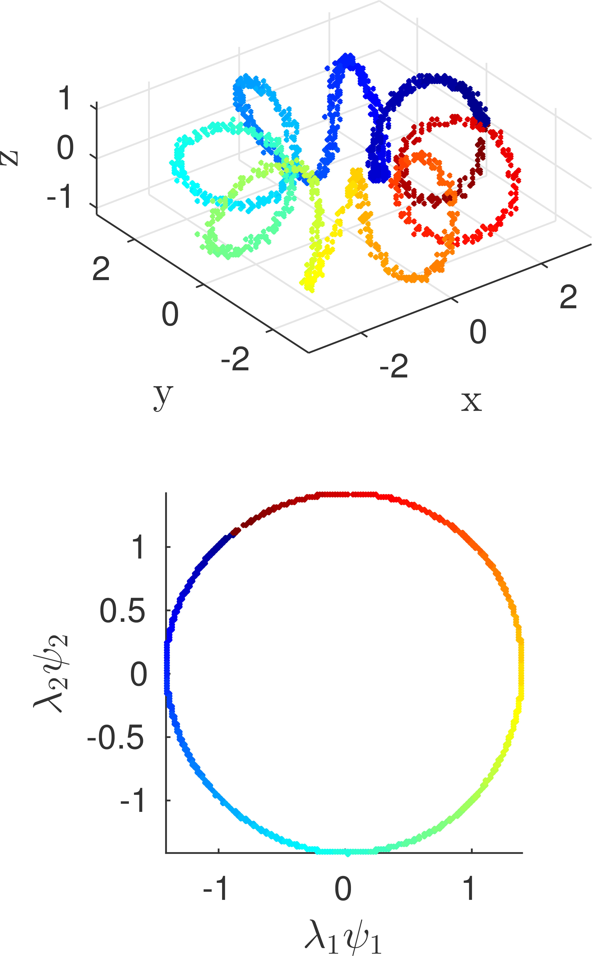
Diffusion map
Discern the low-dimensional structure by leveraging diffusion distances as a metric.​
Euclidean distance amongst the diffusion coordinates is an effective approximation of the diffusion distance.​
The diffusion distance can be calculated using the eigenvectors. It is sufficient to use only the first k eigenvectors and eigenvalues to achieve dimensionality reduction.
Courtesy: Diffusion map - Wikipedia
Notes:
Diffusion map embeds data in a lower-dimensional diffusion space, such that the Euclidean distance in this space approximate the diffusion distance between points.

Slide 7
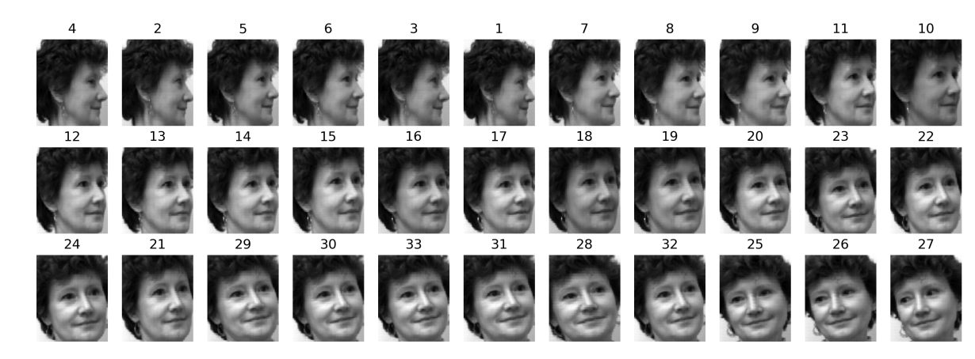
Diffusion map - results
Exhibit a smooth transition in angles
Certain discrepancies are evident: some highly similar images not correctly placed; faces turning to left are at the end
Notes:
This figure shows the ordering results.
We can see that the diffusion map works well, but they are some problems.
First, some highly similar images are not correctly ordered.
Second, faces turning to the left are placed at the end, which are not correct.
As mentioned before, this is because the algorithm orders the faces using monotonic changes of coordinates.
However, the real pattern is that the woman first turned to right, and left, and then right.
So, the algorithm partial fails.

Slide 8
MDS
Designed to reconstruct Euclidean coordinates from pairwise distances or dissimilarities.
Two key steps:
(a) Convert the squared distance matrix D into a matrix that represents inner products;
(b) Carry out eigen-decomposition on the new matrix of inner products.
MDS
Notes:
MDS is a method designed to reconstruct Euclidean coordinates from pairwise distances or dissimilarities.
It has two key steps:
(a)Convert distance matrix D into a kernel matrix.
(b)Carry out eigen-decomposition on the kernel matrix.

Slide 9
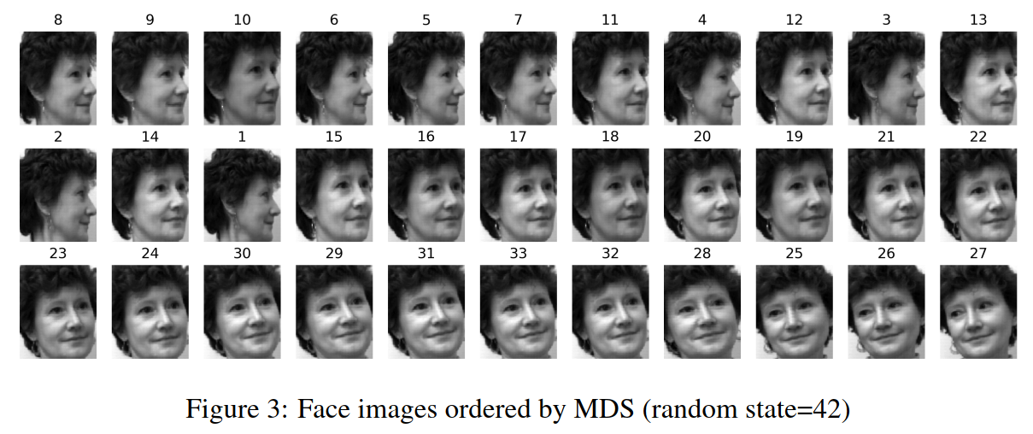
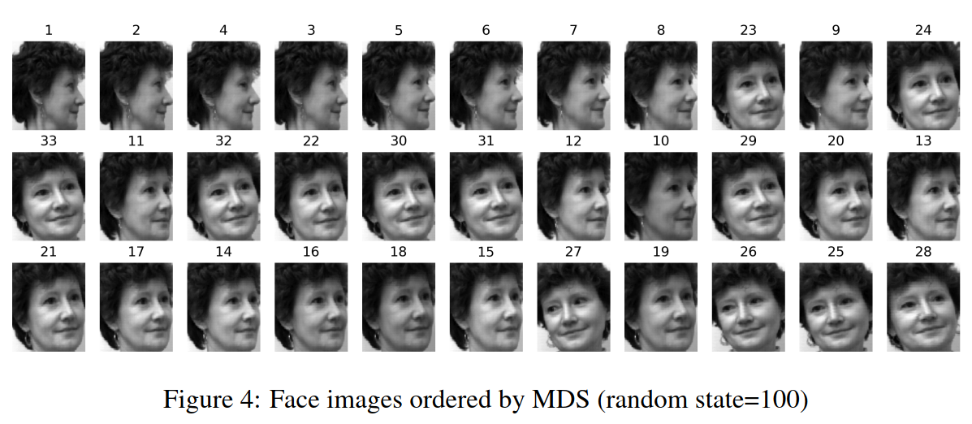
MDS-results
Results using MDS algorithm in scikit-learn are influenced by the random seed.
Only partially capture the correct ordering of images.
Average result (100 runs) still did not show significant improvement.
Notes:
We use SK Learn to implement the MDS, but we found the results are affected by the random seed.
These are the ordering results using two random seeds.
We can see that MDS only partially capture the correct ordering of images.

Slide 10
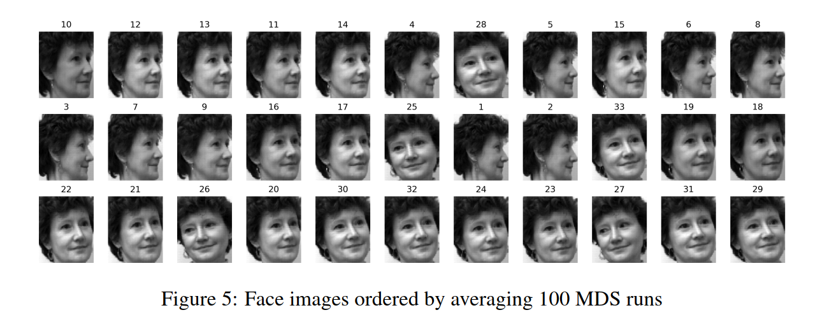
MDS-results
Results using MDS algorithm in scikit-learn are influenced by the random seed.
Only partially capture the correct ordering of images.
Average result (100 runs) still did not show significant improvement.
Notes:
Then I take 100 different random seeds and average the results.
We can see that the averaged result is still not good.
This is because the classical MDS is essential linear, so it is does not work well for data points in highly nonlinear manifolds, , which is the case for this dataset.
So, it is better to consider other nonlinear methods.

Slide 11
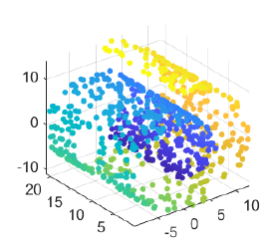
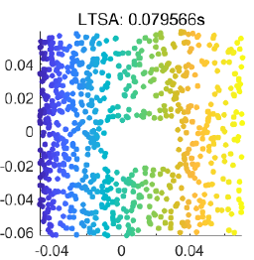
LSTA
LSTA
(1) SVD(Xki) for k Nearest neighbors
(2) Obtain Alignment Matrix
K: = F(Vk, S）
(3) choose d+1 smallest eigenvectors(K)
Drop the smallest
Notes:
LTSA---Local tangent space alignment, which applies PCA locally to obtain the basis of local tangent space and align these spaces.
It considers both the local and global structure and well known for its good performance on embedding the swiss roll.
The main step of the algorithm includes:
1) Compute Local SVD of neighborhood Matrix X for k Nearest neighbors for each point.
2) Obtain Alignment Matrix K which is calculated from the top d dimension right singular vectors from local SVD and selection Matrix S.
3) Choose the smallest d+1 eigenvectors of K and drop the smallest eigenvector to realize the d-embedding.

Slide 12
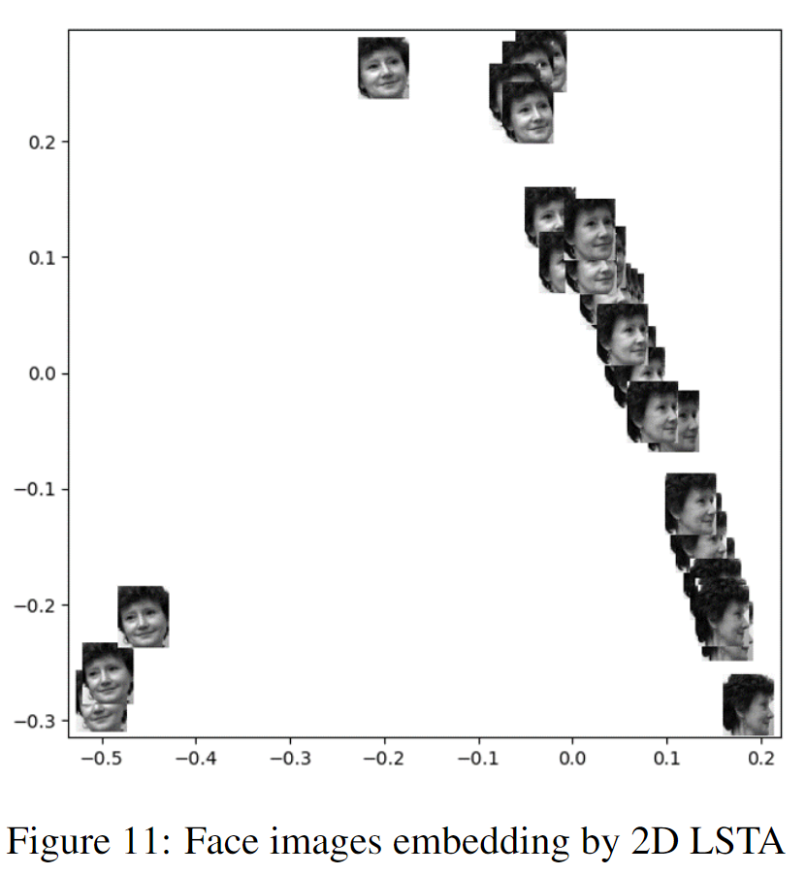
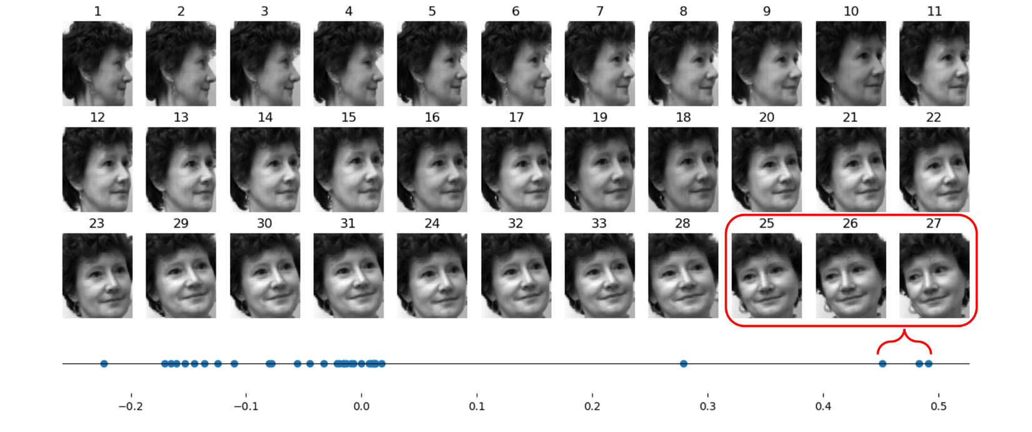
LSTA-results
Results using LSTA algorithm in scikit-learn are influenced.
Face images ordered by 1D LSTA with corresponding 1D embedding axis. The number above each image represents default order in the original dataset. The red box circles the noisy data in the default order
Notes:
The result is also looks good. We can see images 25 to 27 marked in the red box, the actual rotation angle is more than 90 degrees
while the head in the rest of the images is rotated within 90 degrees. We consider these images as
noisy data in default order. In 2D map, their corresponding data points also have a large gap from the rest of the
data points on the axis, which implies that LSTA may learn the angle of rotation from the images.
Compared to ISOMAP, local tangent spaces alignment enables LSTA to capture more local variations,
which is critical for our objective (ordering) that the rotations are visually trivial among neighbor images.
The whole pairwise geodesic distances, which ISOMAP tries to preserve, make the embedding
focus on the global manifold. As a result, ISOMAP shows a more sparse scatter plot in 2D
embedding

Slide 13
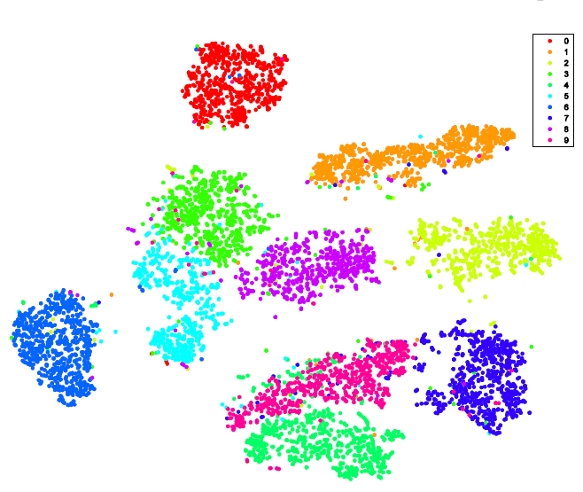
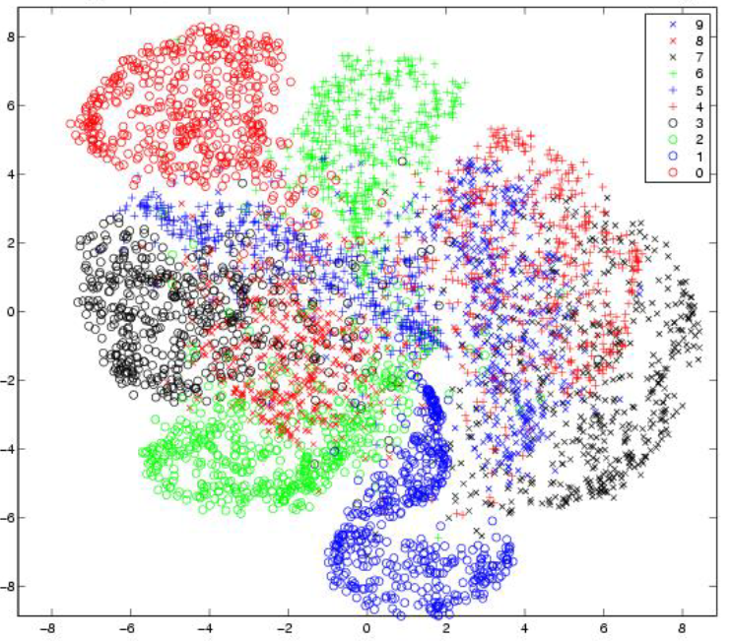
2D t-SNE
t-SNE
t-SNE vs SNE
for MNIST
(1)
p = Prob(||xi, xj||²) (for all point-pairs)
y_{i} = initial(x_{i}),
q = Prob( Prob(||y_{i}, y_{j}||²)
Cost = KL(P, Q),
and update the point position in low-dimension space by gradient descent
Notes:
(t-SNE)----t-Distributed Stochastic Neighbor Embedding, which replaces the normal distribution in SNE with t-distribution and turns conditional probabilities into pairwise probabilities (Symmetric probabilities).
It is well known for bringing a larger gap among clusters in low dimensional embedding, the most typical case is the embedding for the MINIST dataset as the figure shows.
The main step of the algorithm includes:
1) Compute the joint probability of being a neighbor between two points (for all point-pairs) based on their Euclidean distance.
2) Initialize the position of data points in low-dimensional space and calculate the corresponding joint probabilities distribution.
3) Compare the two probability distributions according to KL divergence and update the point position in low-dimension space by gradient descent.

Slide 14
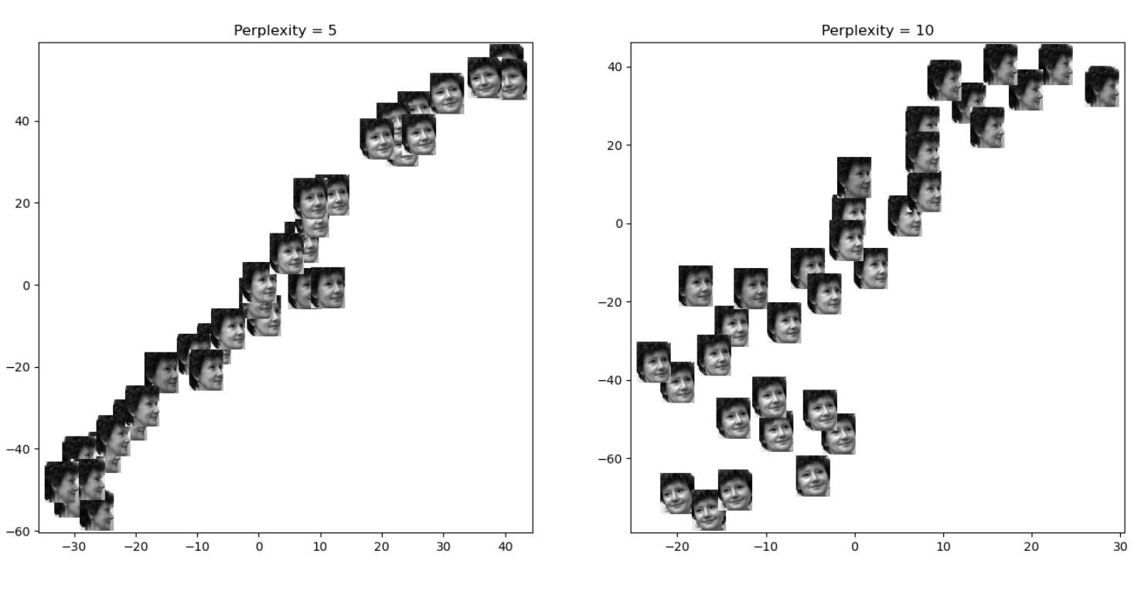
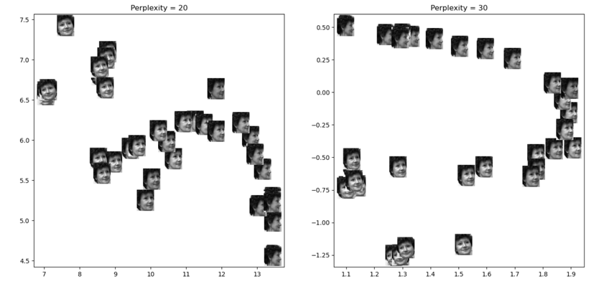
t-SNE-results
Face Images Embedding by 2D t-SNE under different Perplexity
Notes:
We explore 2D t-SNE embedding around perplexity, as it is the key hyperparameter besides the embedding dimension.
The choice of perplexity can significantly affect the embedding results As shown in Figure 12.
Perplexity measures the probability distribution used to model the neighborhood
of a point, and high perplexity indicates a wider Gaussian (higher tail).
The data points are more dispersed and tend to form more clusters with higher perplexity. This can be attributed
to low perplexity paying more attention to the local neighbors, while high perplexity considers more distant points.
Therefore, low perplexity embedding is preferred for ordering the face images.

Slide 15
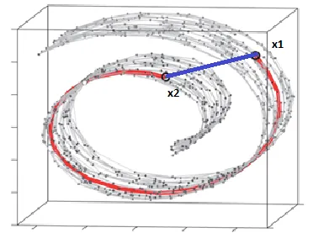
ISOMAP
A nonlinear dimensionality reduction method used to process and visualize the face data
Constructs a neighborhood network by connecting each point to its nearest neighbors.
A distance matrix is created by computing geodesic distances between all point pairs
courtesy:https://www.deeplearningitalia.com/manifold-based-tools-isomap-algorithm/

Slide 16
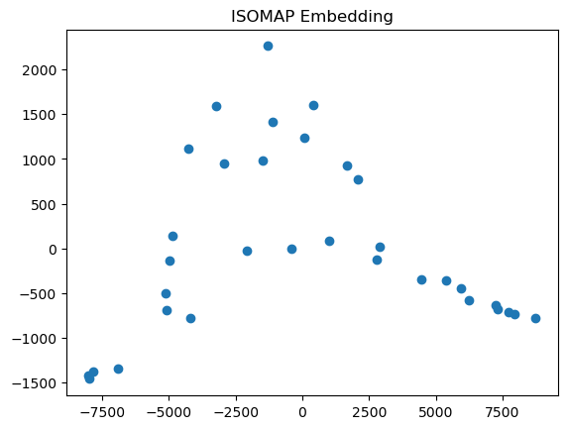
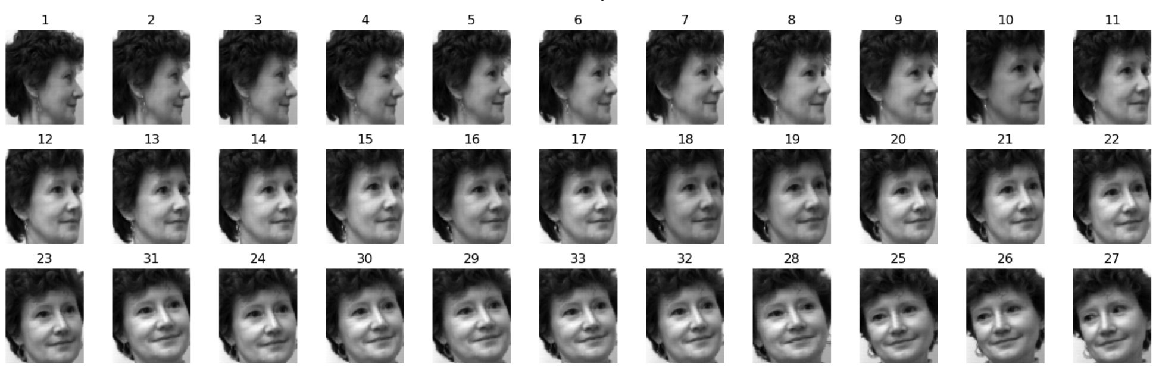
ISOMAP-results
ISOMAP algorithm with k=5 nearest neighbors effectively used for face ordering
Clear, gradual transition of faces observed.
First 23 labels identical in ISOMAP and Ground Truth
Face images ordered by ISOMAP
ISOMAP Embedding
Notes:
The suboptimal performance of MDS can be explained by its fundamental objective of finding an affine space to represent the underlying data structure.
This method is not well-suited for capturing data points that reside in manifolds exhibiting high nonlinearity in their geometric features.
In such cases, it is advisable to consider nonlinear dimensionality reduction algorithms.

Slide 17
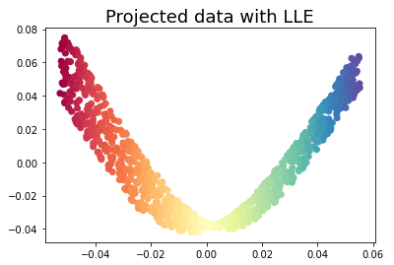
LLE
Allows us to capture the smooth transitions we aim for when ordering the face images
It is another nonlinear dimensionality reduction method used in the study
Measures how each data point relates to its nearest neighbors, and constructs a low-dimensional embedding of the data preserves these local relationships.
courtesy: https://michael-fuchs-python.netlify.app/2020/08/12/manifold-learning/

Slide 18
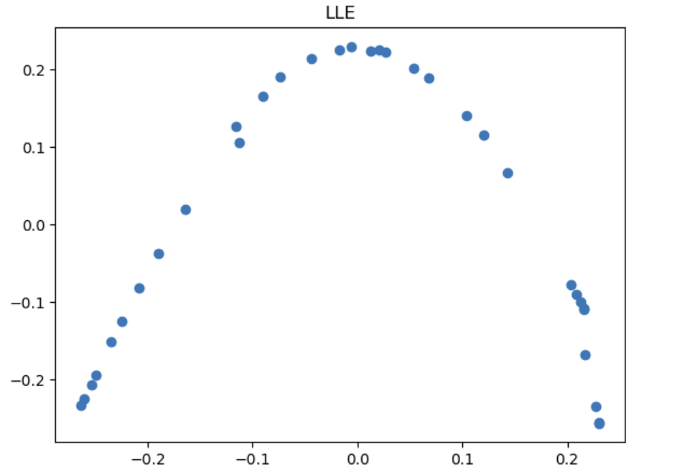
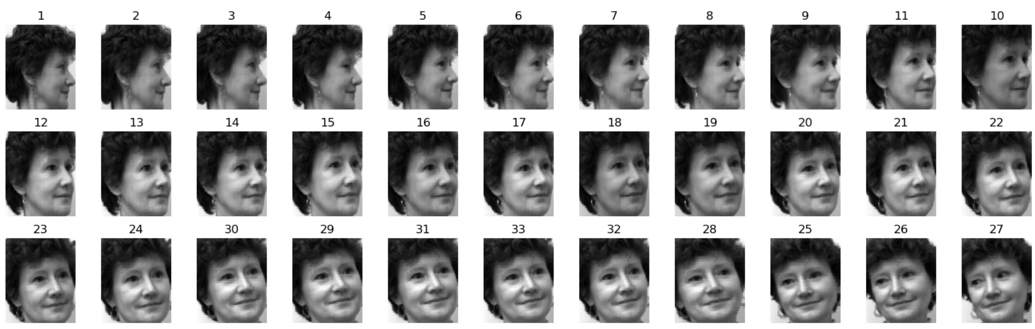
LLE-results
Found identical ordering for the first 24 labels (except 10 and 11) in both LLE and Ground Truth, indicating preservation of original order.
Observed a uniform distribution of faces, highlighting the effectiveness of local linear approximations.
Face images ordered by LLE
LLE Embedding
Notes:
The suboptimal performance of MDS can be explained by its fundamental objective of finding an affine space to represent the underlying data structure.
This method is not well-suited for capturing data points that reside in manifolds exhibiting high nonlinearity in their geometric features.
In such cases, it is advisable to consider nonlinear dimensionality reduction algorithms.

Slide 19
Manifold learning methods comparison

Slide 20
Comparison metric
Quantifies the similarity between two orderings
τ close to 1 indicates a high level of agreement
Kendall’s Tau coefficient (τ)
scipy.stats
τ close to -1 signifies significant disagreement
τ around 0 indicates a lack of significant relationship
Also provides a corresponding p-value
p-value > 0.05, lack of significant correlation between algorithm' ordering and true ordering
p-value <= 0.05, statistically significant relationship between algorithm' ordering and true ordering
Notes:
In this study, we utilize Kendall’s Tau coefficient (τ) as our metric of choice.
This coefficient quantifies the similarity between two orderings.
A τ close to 1 indicates a high level of agreement, while a τ close to -1 signifies significant disagreement, and a τ around 0 indicates a lack of significant relationship.
To calculate Kendall’s Tau, we utilize the implementation available in the scipy.stats module of Python, which also provides a corresponding p-value.
A p-value less than or equal to 0.05 indicates strong evidence against the null hypothesis, suggesting a statistically significant relationship between the algorithm’s ordering and the ground truth ordering.
Conversely, a p-value greater than 0.05 suggests insufficient evidence to reject the null hypothesis, indicating a lack of significant correlation between the algorithm’s ordering and the ground truth.

Slide 21
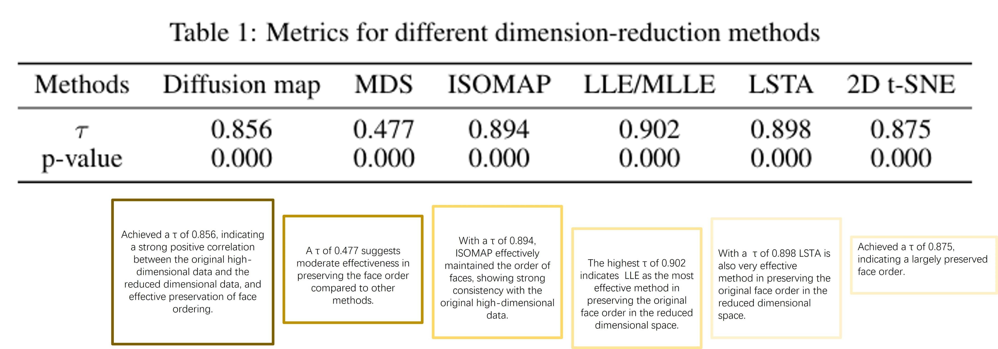
Metrics for different methods
Remarks
To preserve face ordering when reducing dimensionality, LLE appears most effective.

Slide 22
Thank You

